Slide 1
Intro to Analysis Assistant Tool
William

Slide 2
Agenda
Purpose
Technology and Algorithm
Prototype & Function
Problems need to be resolved

Slide 3
Purpose
Automatically detect anomaly points in time series data
Assist Analysts to perform deep dive on issues worth attention

Slide 4
Technology and Algorithm
UI
Server
Function Library
Technology
R
Packages needed to run the program
Shiny
Reshape
* Please install these two packages before running the program
Algorithm
Detection
Absolute(Average(Current_5_Day) – Average(Past_5_Day)) > Threshold
Threshold = f(ThisYear_30_Day_Variance, LastYear_30_Day_Variance)
* Weight assigned to this year and last year can be adjusted accordingly
Analysis
Create subset of data using different filters, compare the subset data trend with the overall data trend, the higher the correlation is between subset and overall, the more likely the filter chosen causes the issue
Subset = filter(Data)
Try all possible combination of filters
Order(Correlation(Filtered Trend, Overall Trend))

Slide 5
Prototype & Function
Testing Data
2012-01-01 to 2014-06-01 social GMB and BI data
Attributes included
Browser Type
Browser Version
Social Channel
BI
GMB
Device Type
Site
*Some Functions of the prototype has been hard coded to fit this data set

Slide 6
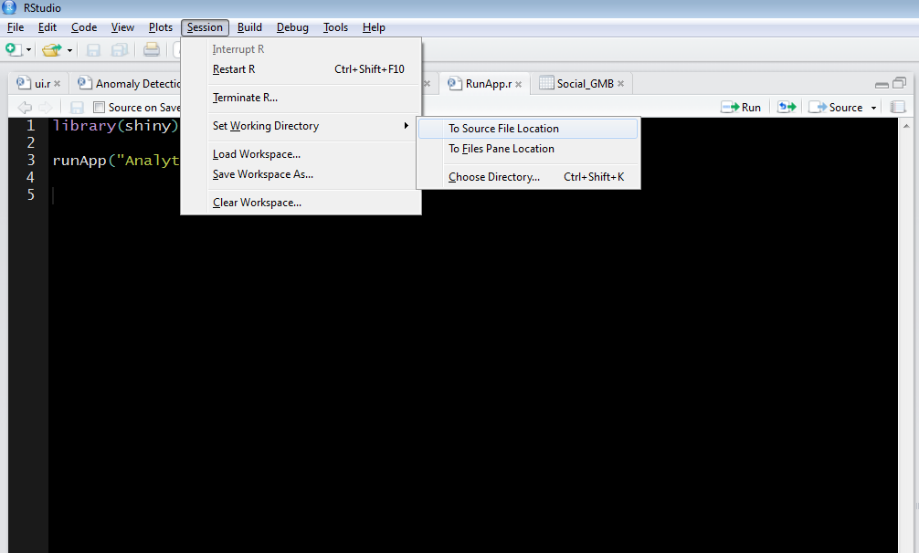
Prototype & Function
Open the “RunApp.r” file and set working directory to Source File Location
Run the “RunApp.r” File

Slide 7
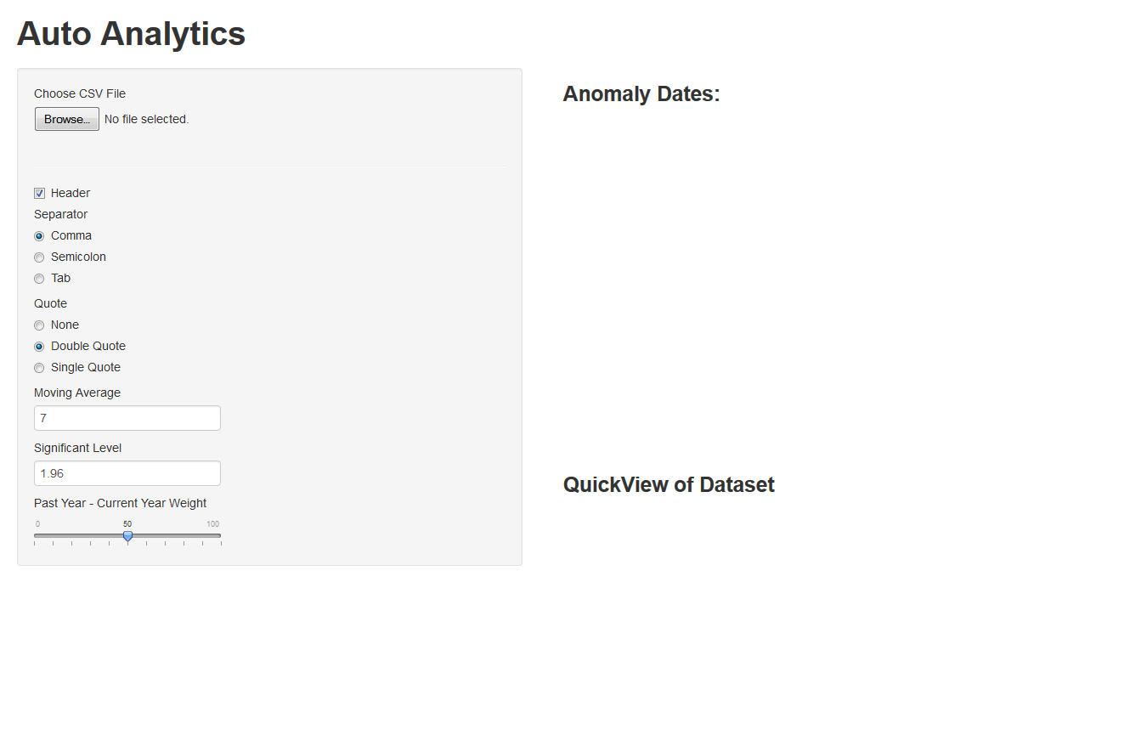
Prototype & Function
In your browser, you should have page popped up like this

Slide 8
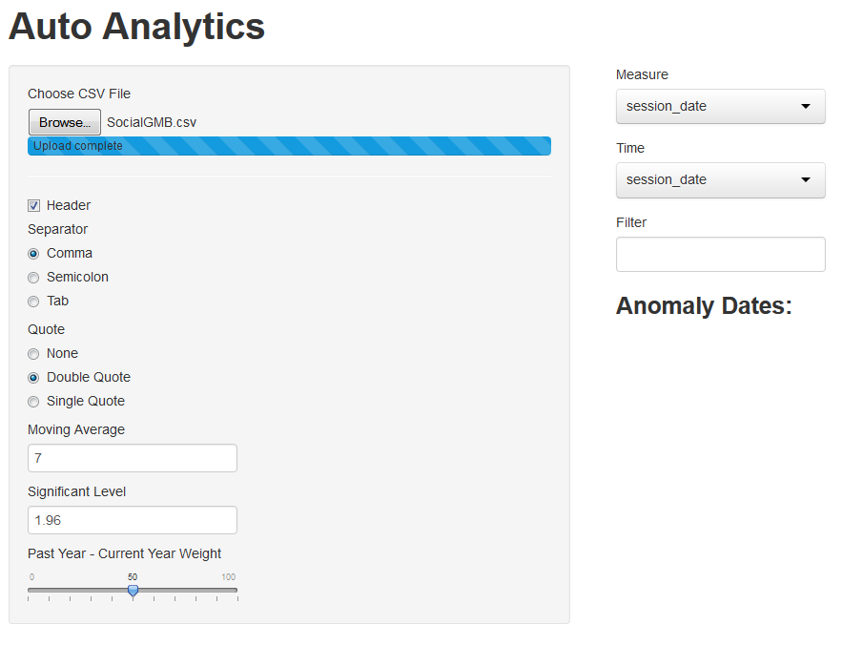
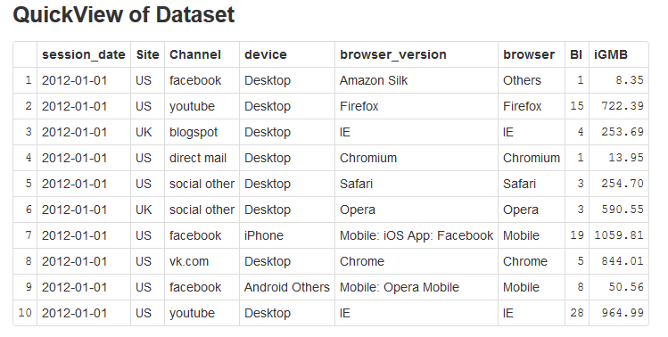
Prototype & Function
Choose the local csv file to be analyzed, in this case, choose “SocialGMB.csv”
After loading the data, the page will present a sample of data and pop up some fields for choose.

Slide 9
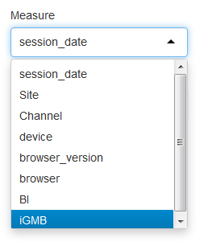
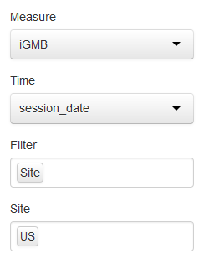
Prototype & Function
In this prototype, we can analyze the GMB or BI, so choose either GMB or BI as measure in the first drop down box
Select the column that specifies time, here is session_date
Select Filter if necessary, I just tested filter for Site
And choose the option for the filter, here choose “US”

Slide 10
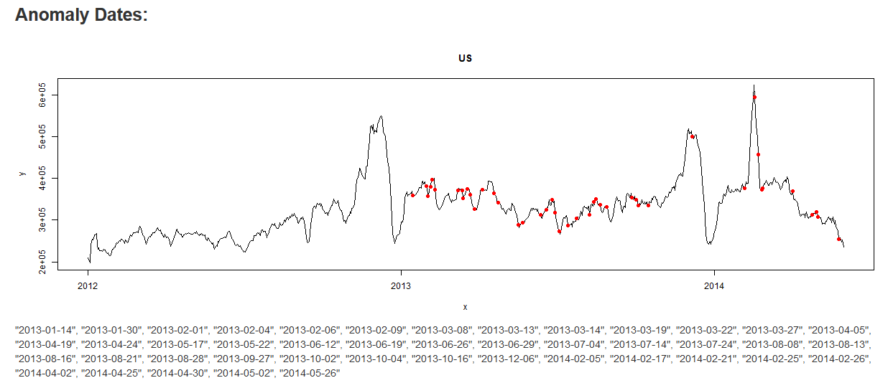
Prototype & Function
After entering the filter options, it will automatically run the program and present the auto detection result
The result should list suggested anomaly date and highlighted in red

Slide 11
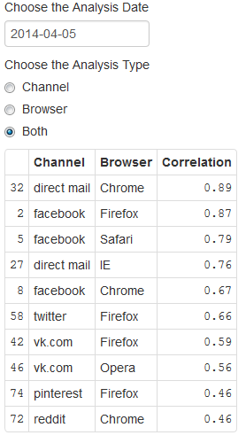
Prototype & Function
Choose the Date to be analyzed and the analysis type
If you believe the date suggested by the previous step is correct and accurate, choose the suggested date, otherwise, choose any date you wish
Result will indicate which combination of parameters has the highest correlation with the overall trend of the chosen date.
* Because the program is designed base on this sample data, it can only choose to analyze browser and channel. For further utilization, this program should have more flexible choices to let user choose the combination.

Slide 12
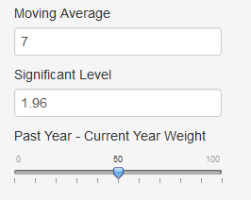
Prototype & Function
If you are not satisfied with the detection result, change the significance level, moving average period and current/past year weight as needed

Slide 13
Problems need to be resolved
Algorithm not solid enough to detect anomaly
More parameters should be taken into consideration
Need more solid model to run anomaly detection
Outliers need to be removed
Outlier will make variance large, so the program is not able to detect certain anomaly points
Requires long period data
Since the program is performing time series analysis, it will require more than 2 years data to properly conduct the detection
Not flexible for other data for now
Most functions in the prototype is hard coded to fit the sample data set. Filter and parameters are not selectable for now because more tweaking is needed to make it flexible enough to handle more user input

